Slide 1
Istituto Magistrale Camillo Finocchiaro Aprile
Via Cilea n.56 – 90144 Palermo
Tel 091.343509

Slide 2
OUR SCHOOL OFFERS TWO COURSES
The High School of Human Sciences
The High School of Human Sciences with Social Economic specialization.
both are a five year course, aiming to acquire skills related to:
➢- training and educational processes
➢- relational problems
➢- communication methodologies
➢- cultural and intercultural processes
➢- economic - legal-social phenomena.

Slide 3
OUR INSTITUTE OFFERS TWO COURSES
The High School of Human Sciences
It draws on the knowledge of the human being, focusing in particular on psychology and the sciences of education, strengthening the study of classical culture through Philosophy and Latin.
The High School of Human Sciences with an economic-social specialization
deepens the knowledge of the social system, focusing in particular on Sociology, Law and Economics, with particular attention to Mathematics. This course also includes the study of a second language.

Slide 4
High School of Human Sciences
Subjects | 1st Year | 2nd Year | 3rd Year | 4th Year | 5th Year
Italian language and literature | 4 | 4 | 4 | 4 | 4
Latin language and literature | 3 | 3 | 2 | 2 | 2
History and Geography | 3 | 3
History |  |  | 2 | 2 | 2
Philosophy |  |  | 3 | 3 | 3
Human sciences | 4 | 4 | 5 | 5 | 5
Laws and Economics | 2 | 2
Foreign language and literarture | 3 | 3 | 3 | 3 | 3
Mathematics | 3 | 3 | 2 | 2 | 2
Physics |  |  | 2 | 2 | 2
Natural Science | 2 | 2 | 2 | 2 | 2
Art |  |  | 2 | 2 | 2
Physical Education | 2 | 2 | 2 | 2 | 2
Religion or Alternative Activities | 1 | 1 | 1 | 1 | 1
 | 27 | 27 | 30 | 30 | 20

Slide 5
HIGH SCHOOL OF HUMAN SCIENCES
Subjects | 1st Year | 2nd Year | 3rd Year | 4th Year | 5th Year
Italian language and literature | 4 | 4 | 4 | 4 | 4
History and Geography | 3 | 3
History |  |  | 2 | 2 | 2
Philosophy |  |  | 3 | 3 | 3
Human sciences | 3 | 3 | 3 | 3 | 3
Laws and Economics | 3 | 3 | 3 | 3 | 3
English language and literarture | 3 | 3 | 3 | 3 | 3
French language and literature | 3 | 3 |  | 3 | 3
Mathematics | 3 | 3 | 3 | 3 | 3
Physics |  |  | 2 | 2 | 2
Natural Science | 2 | 2
Art |  |  | 2 | 2 | 2
Physical Education | 2 | 2 | 2 | 2 | 2
Religion or Alternative Activities | 1 | 1 | 1 | 1 | 1
 | 27 | 27 | 30 | 30 | 20

Slide 6
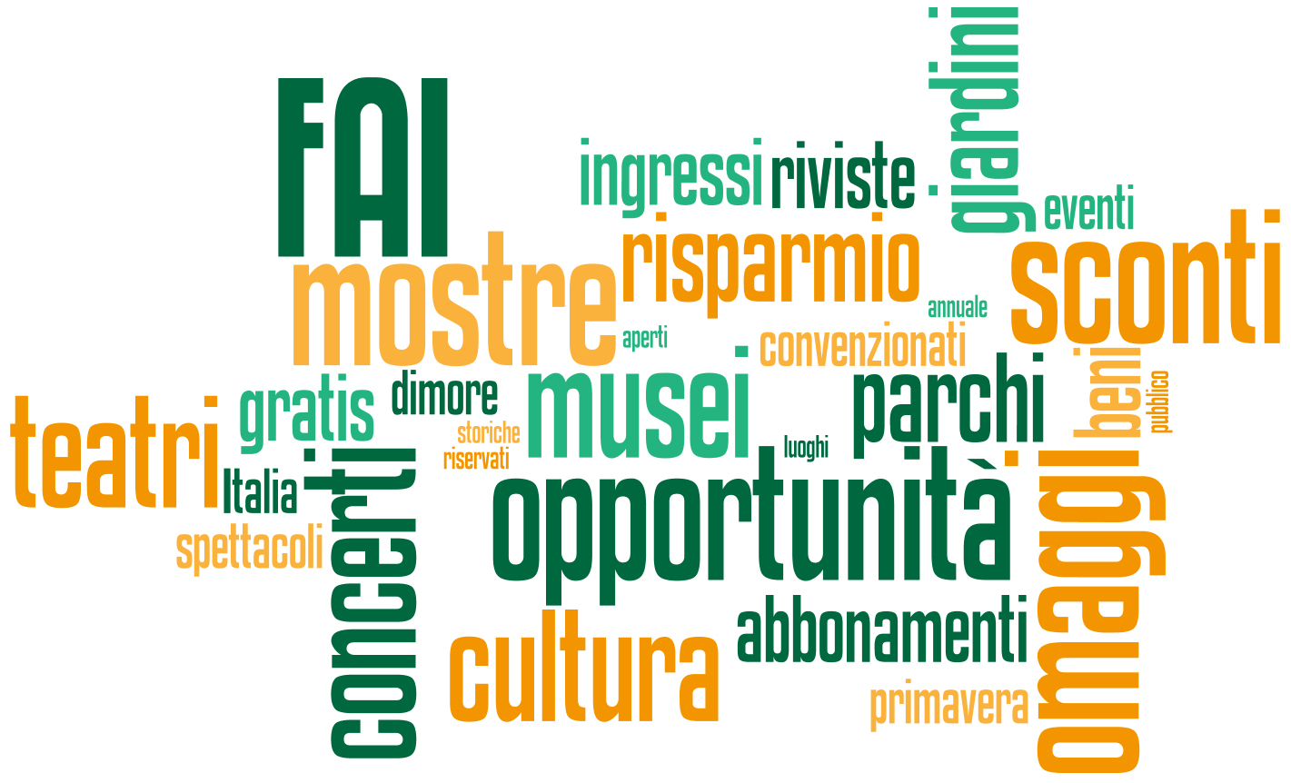
EXTRA CURRICULAR ACTIVITIES
Scientific Area
➢ Ed. To Health
➢Psychological Counselling - C.I.C
➢ Made in Italy - FAI
➢ Solidarity - Inclusion (Telethon, AIL, etc.)
➢ Information -Prevention (cancer, thalassemia, etc.)
➢Conferences with external experts, university and primary faculty (gender identity, motivational laboratories, drugs, alcohol, ludopathy, etc.)

Slide 7
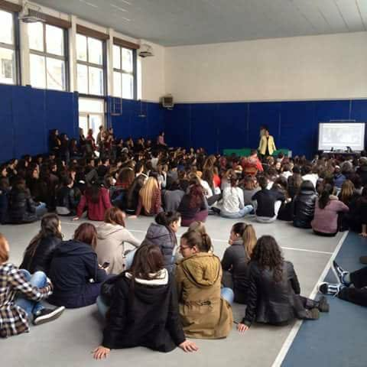
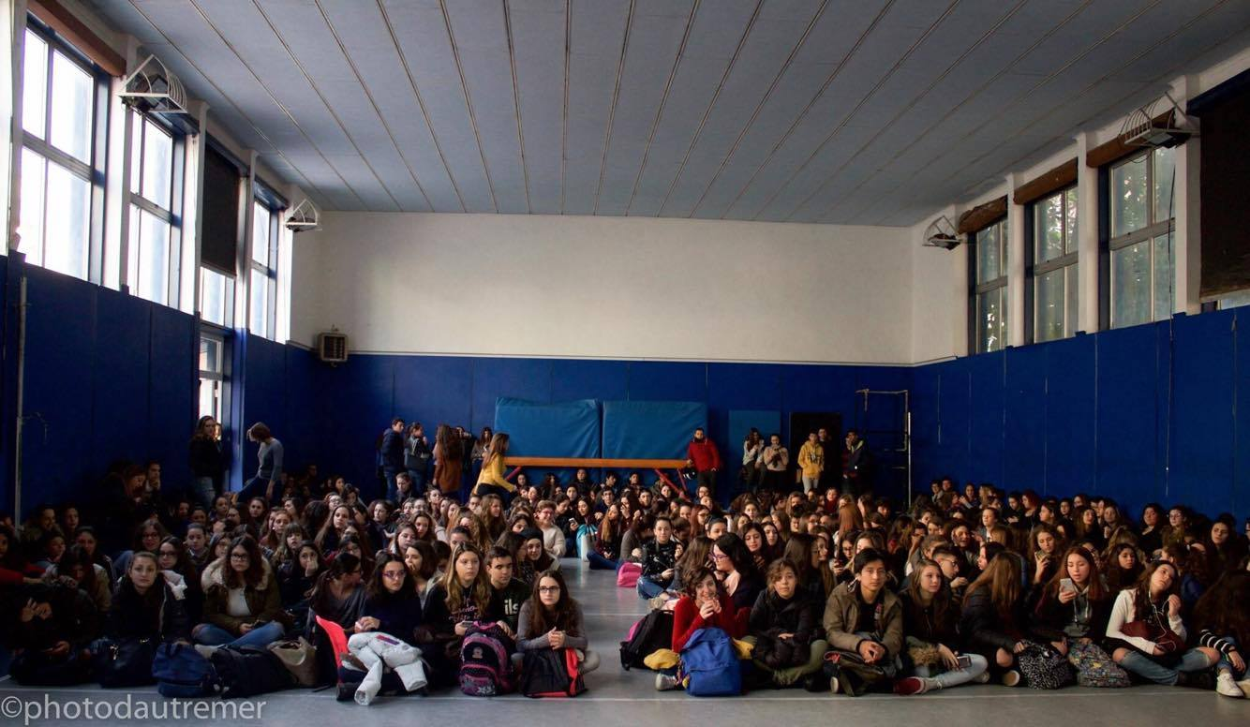
EXTRA CURRICULAR ACTIVITIES
Linguistic-Literary Area
➢B1 Certification courses
➢ German course
➢Mondello Literary Prize
➢Libriamoci (MIUR)
➢Week of Dante's studies
➢Massimo Theatre plays
➢Cinema
➢ Conferences with external experts, historians, writers, magistrates, etc. (Dacia Maraini, S.Formica, Petix, Feltri, Di Matteo, Zoccola etc.)

Slide 8
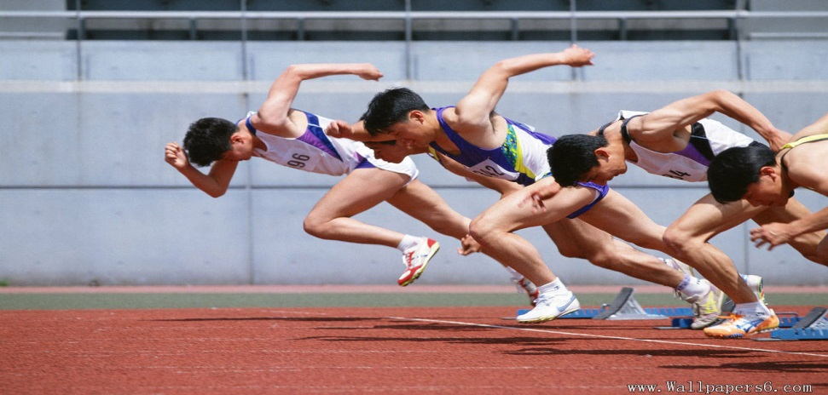
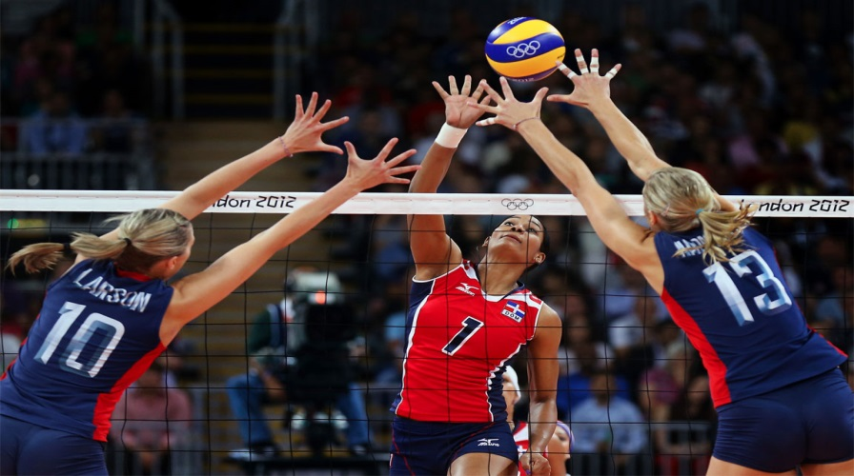
SPORT ACTIVITIES
➢Volley
➢Running
➢ Athletics
➢Tamburello ball
➢Cross-country race

Slide 9
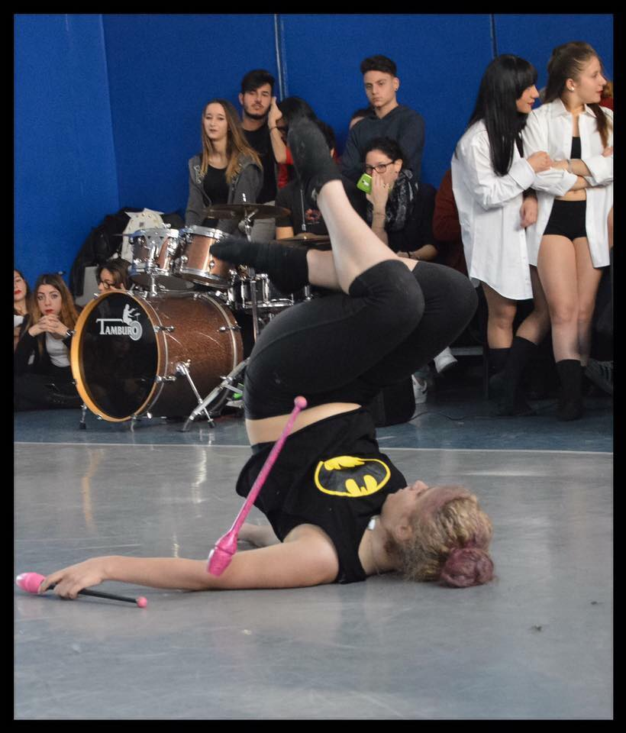
STUDENT WEEK ACTIVITIES
➢THEATRE
➢CINEMA CLUB
➢CINEFILOSOFIA (LEARNING PHILOSOPHY THROUGH
FILM ANALYSIS)
➢LECTURES
➢GROUP WORK LEARNING
➢ MUSIC - PHOTO – WRITING LABS
➢ FINAL SHOW
➢ SCHOOL BAND
➢NIGHT HAPPENING

Slide 10
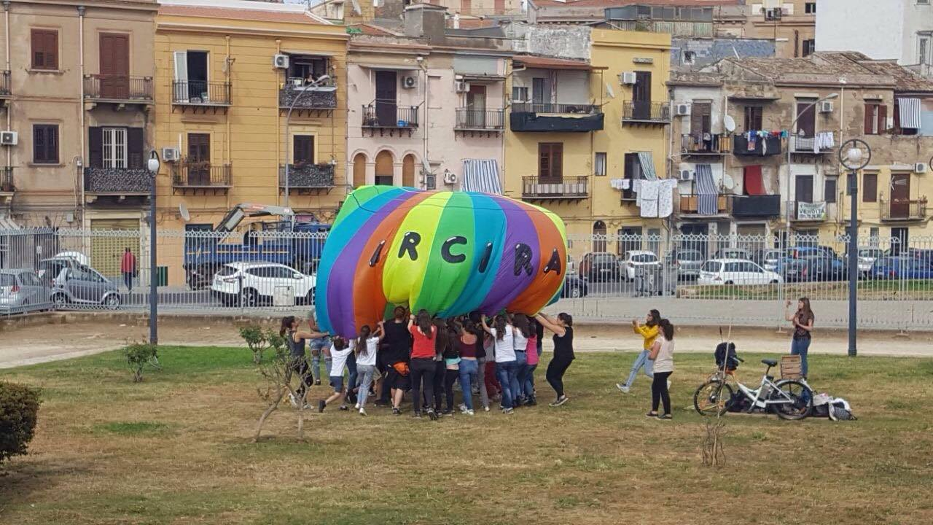
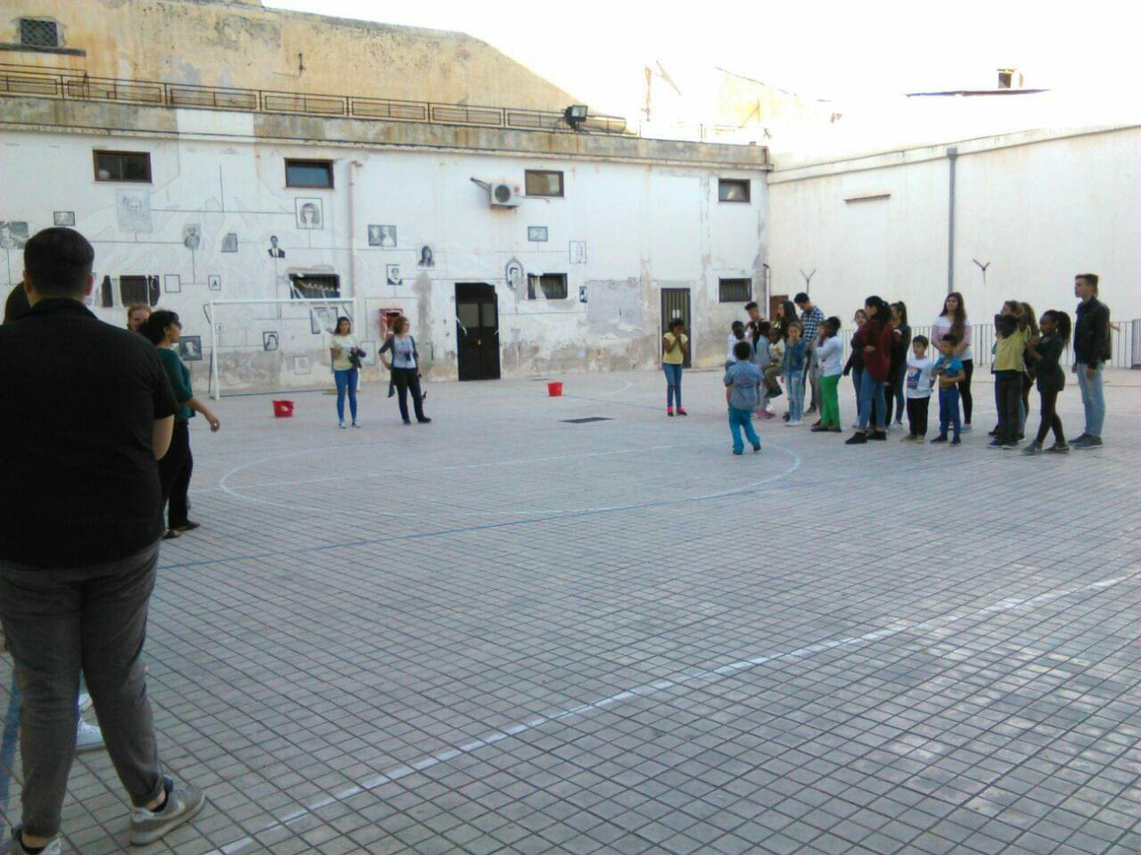
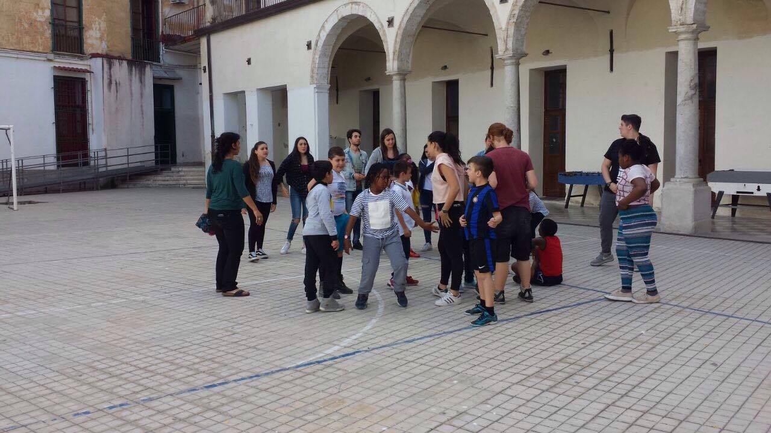
SCHOOL-WORK COURSES

Slide 12
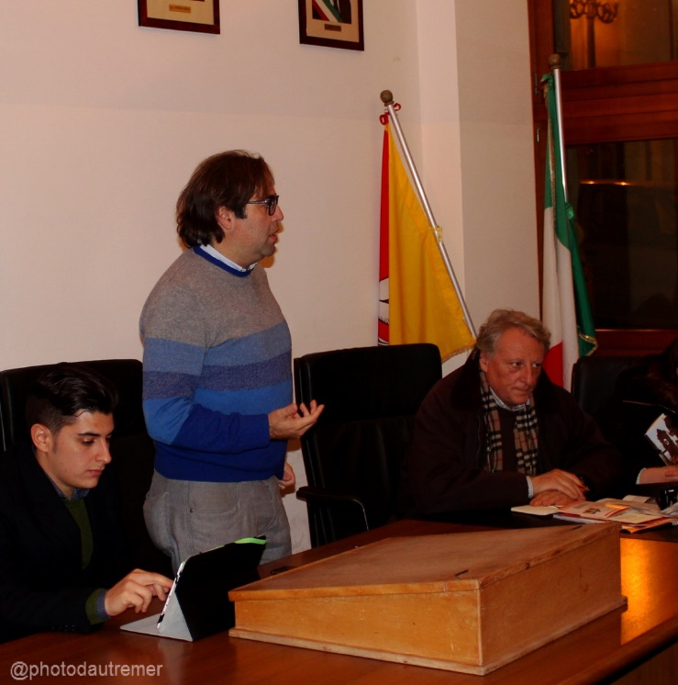
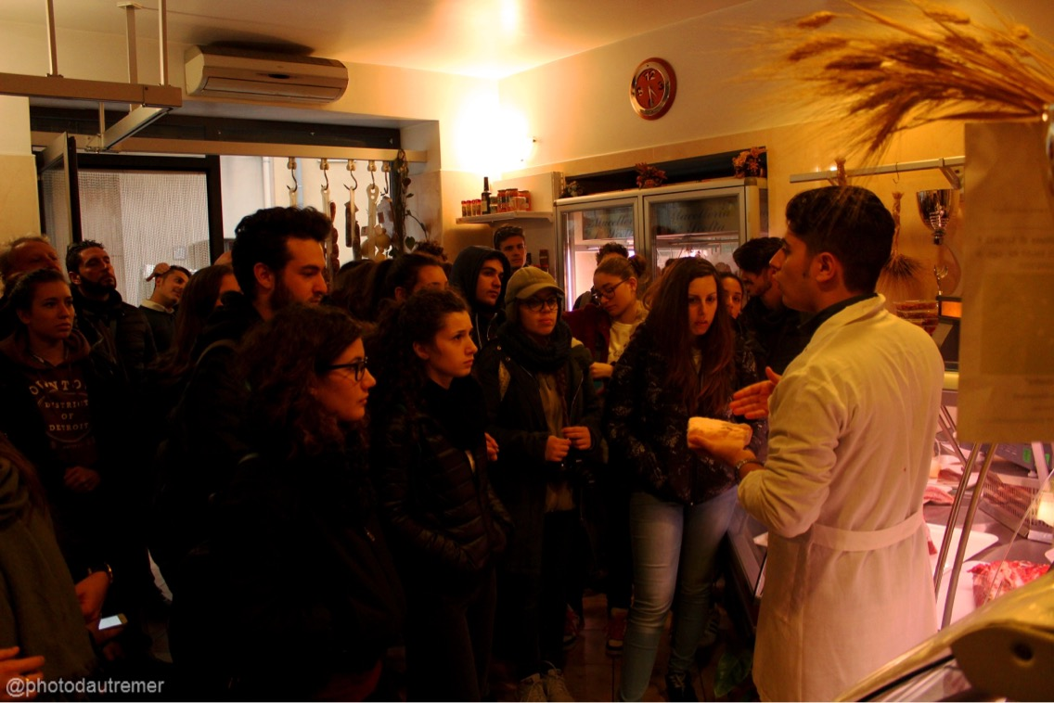
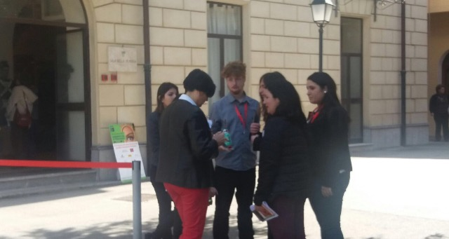
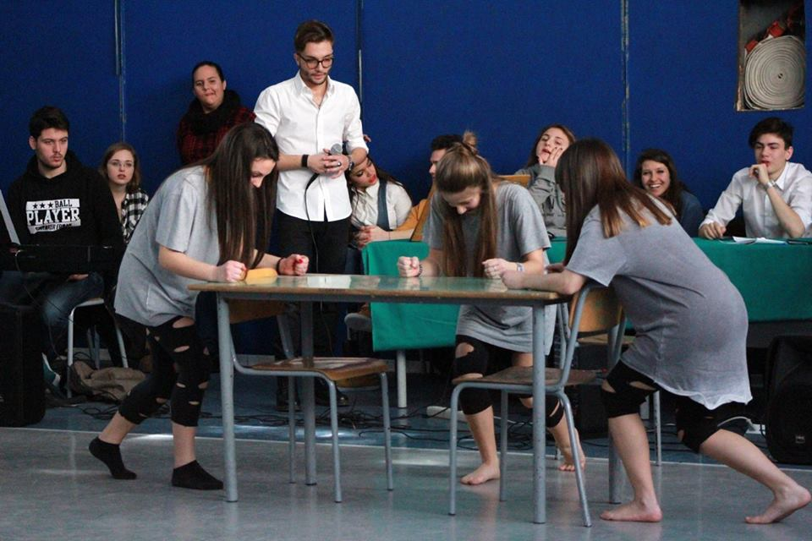

Slide 13
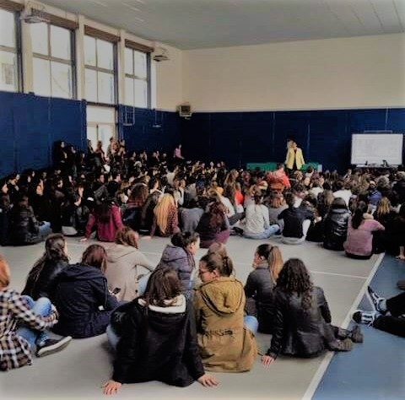
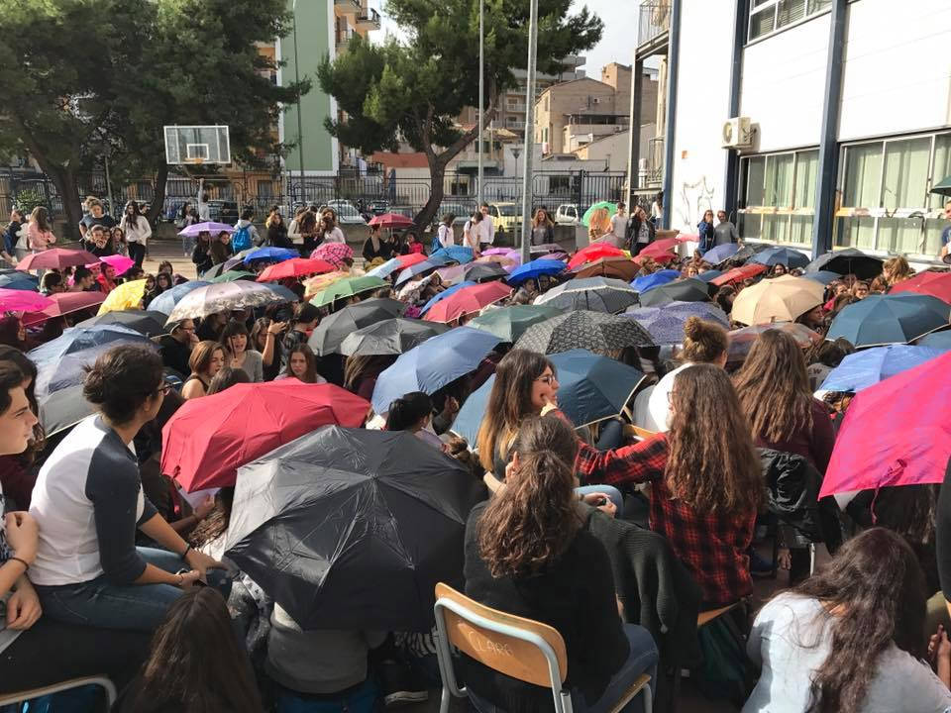
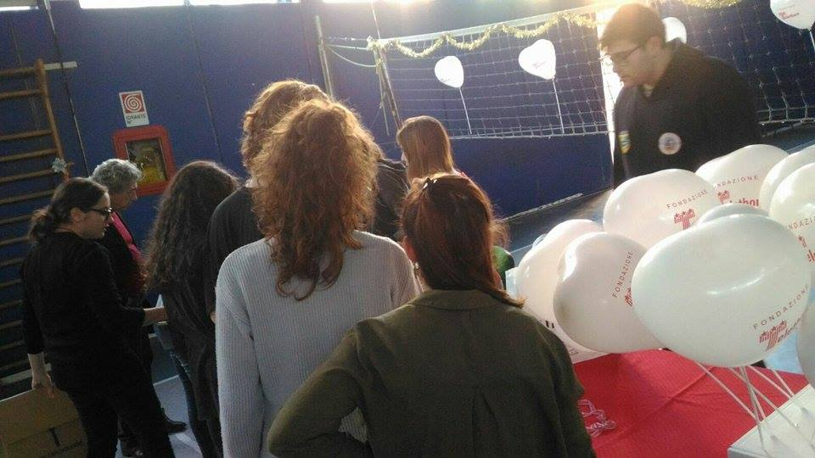
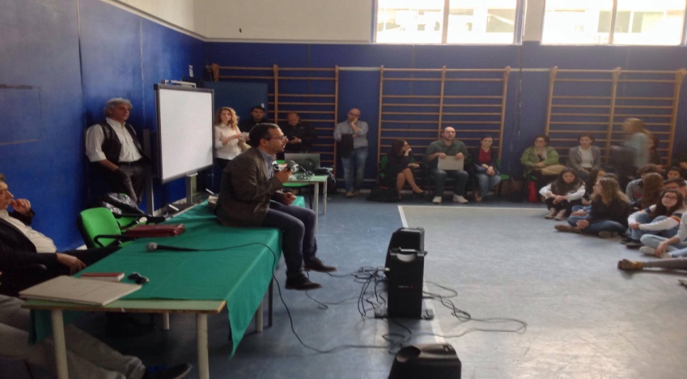
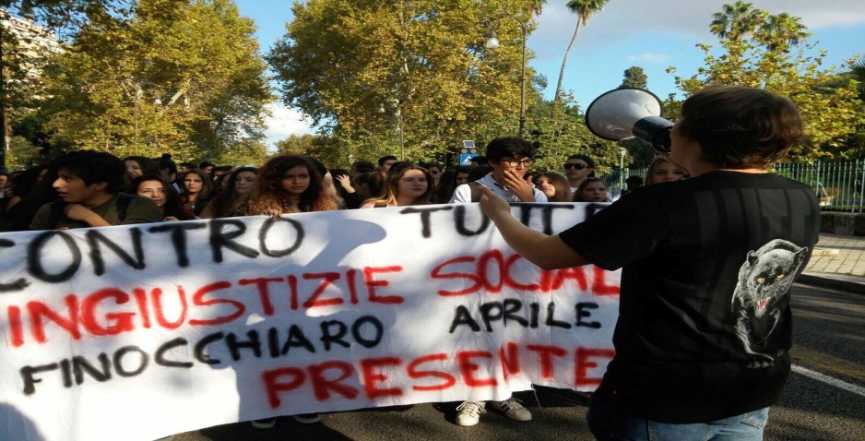
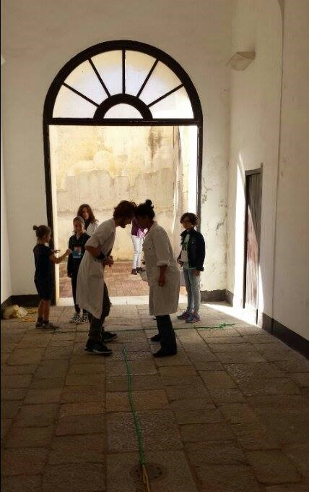
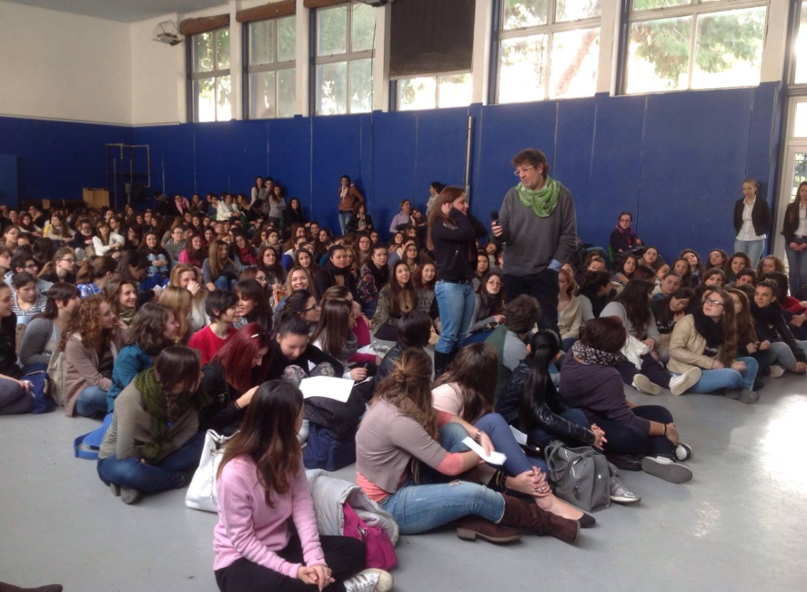
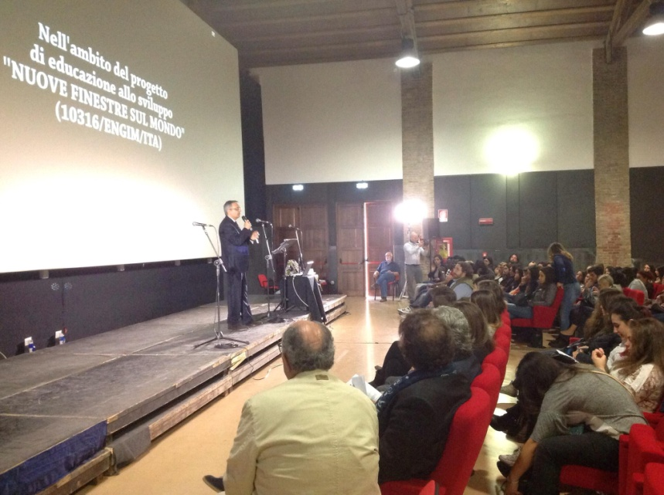

Slide 14
Work – school path
Working with FAI

Slide 15
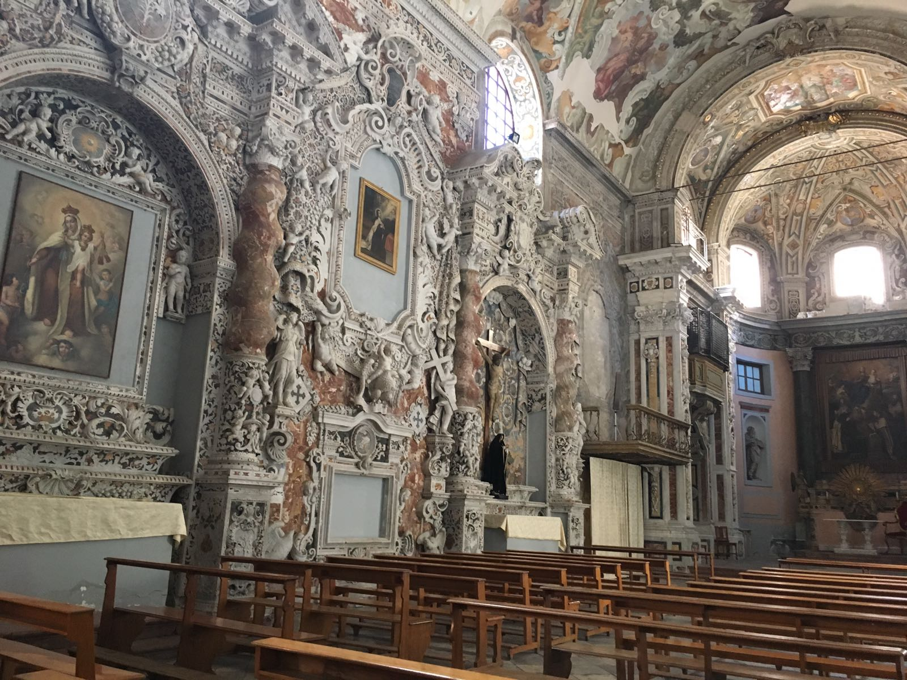
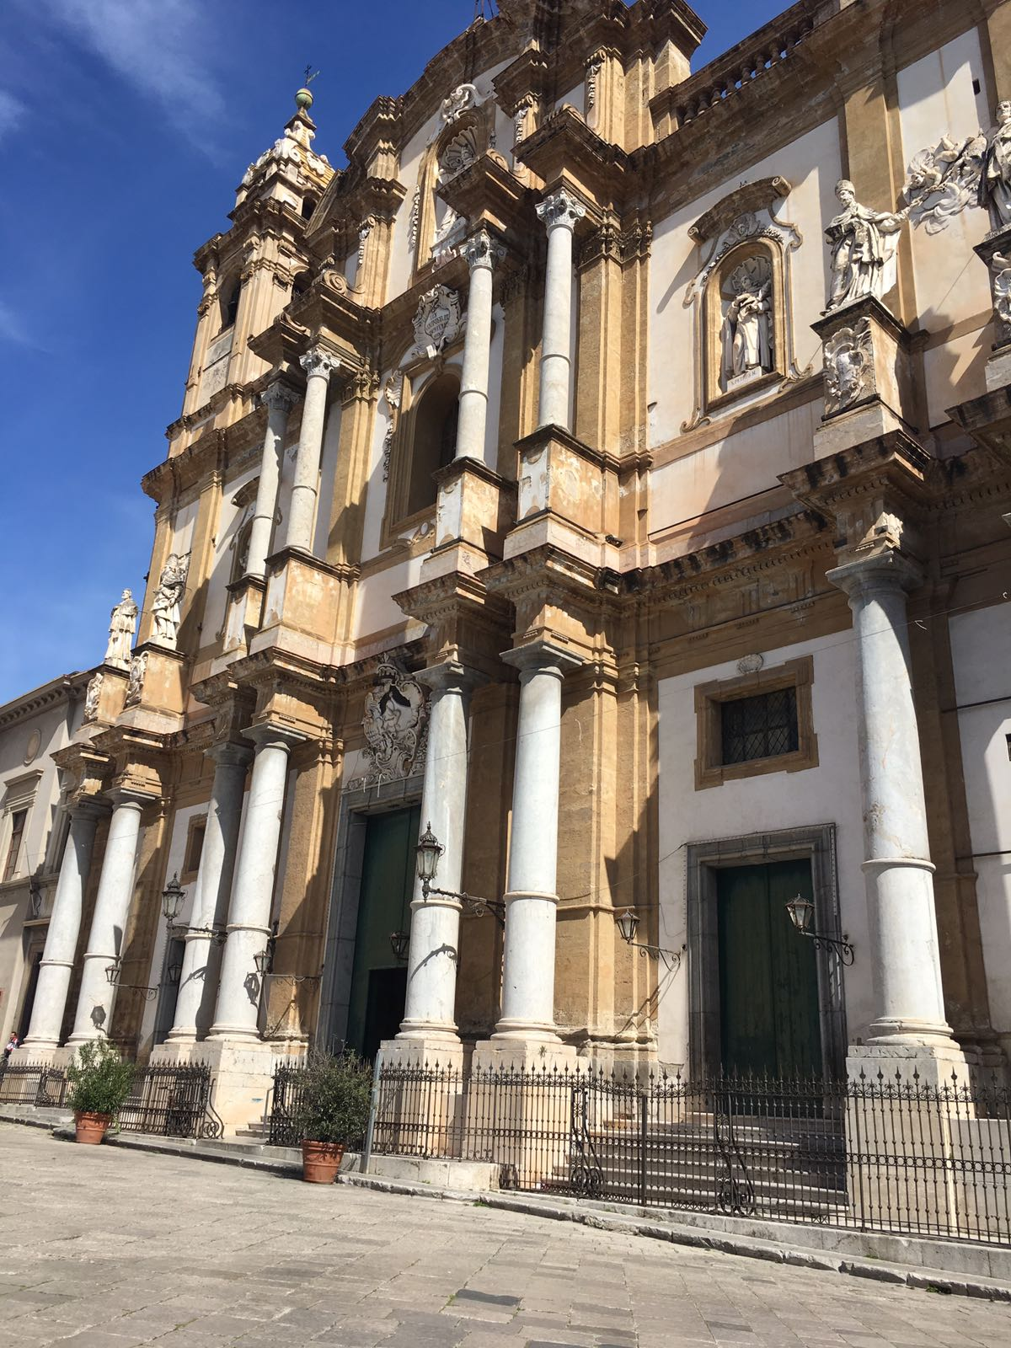

Slide 16
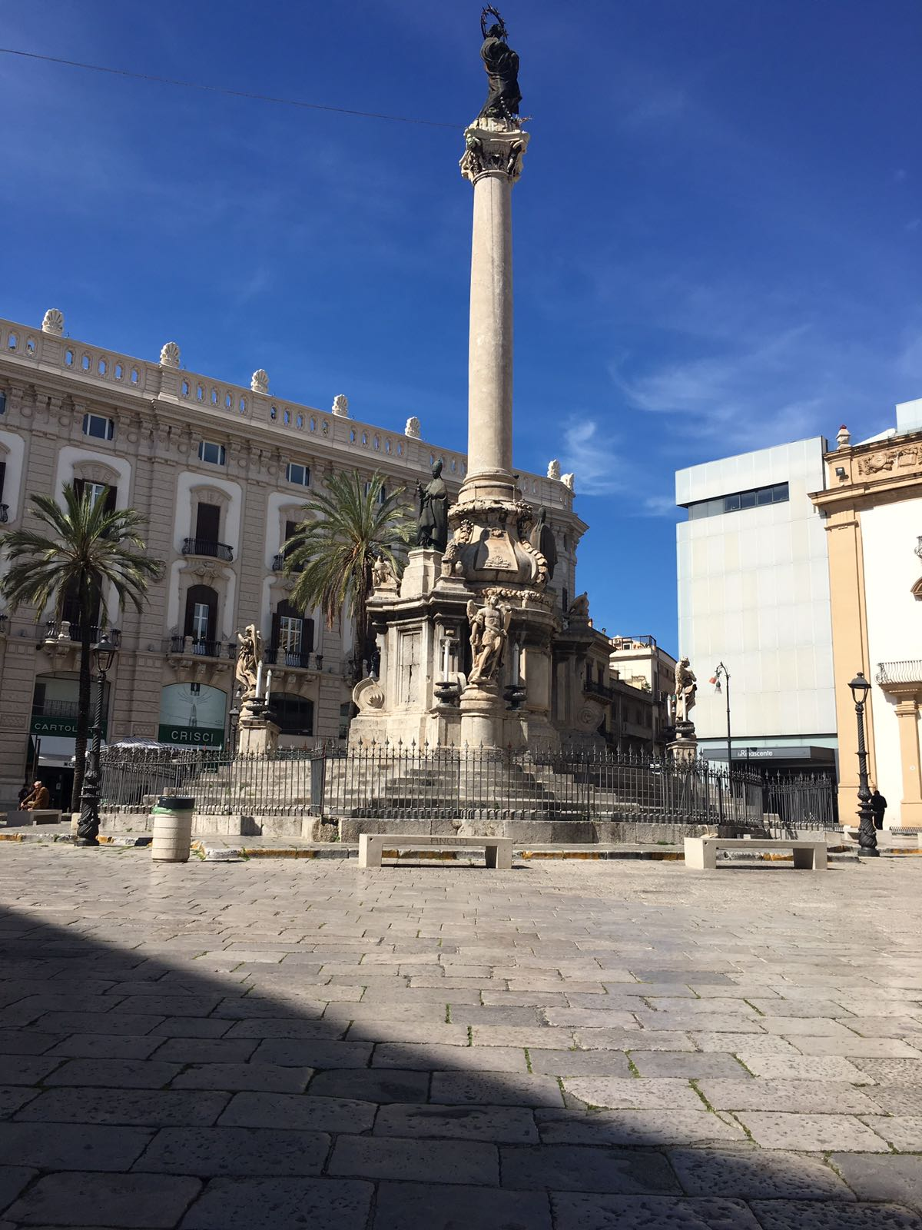
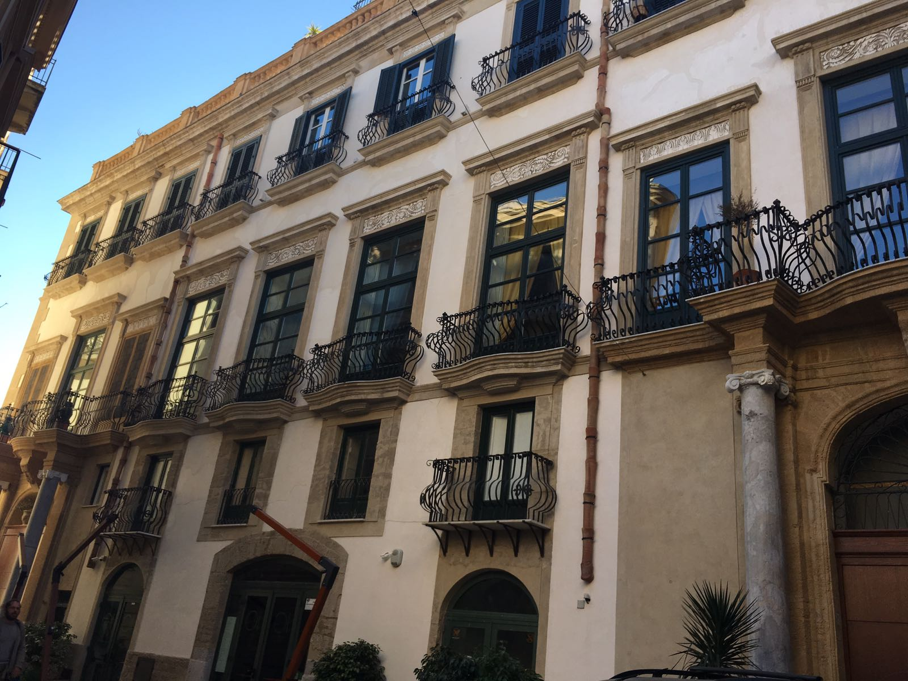

Slide 17
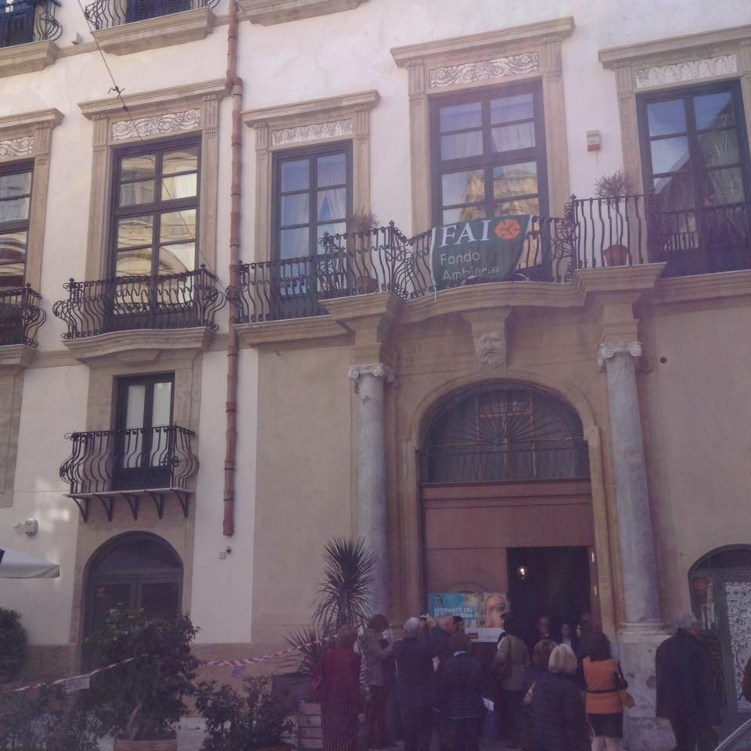

Slide 18
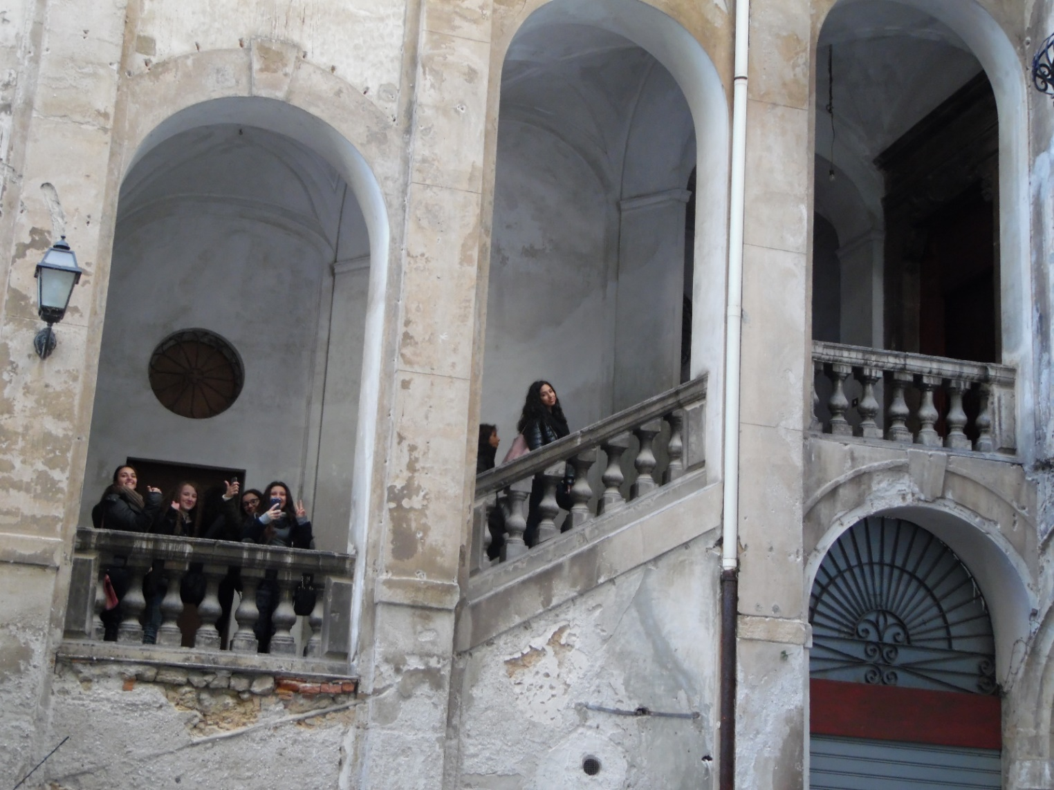

Slide 19
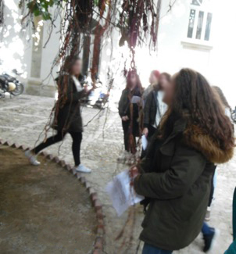

Slide 20
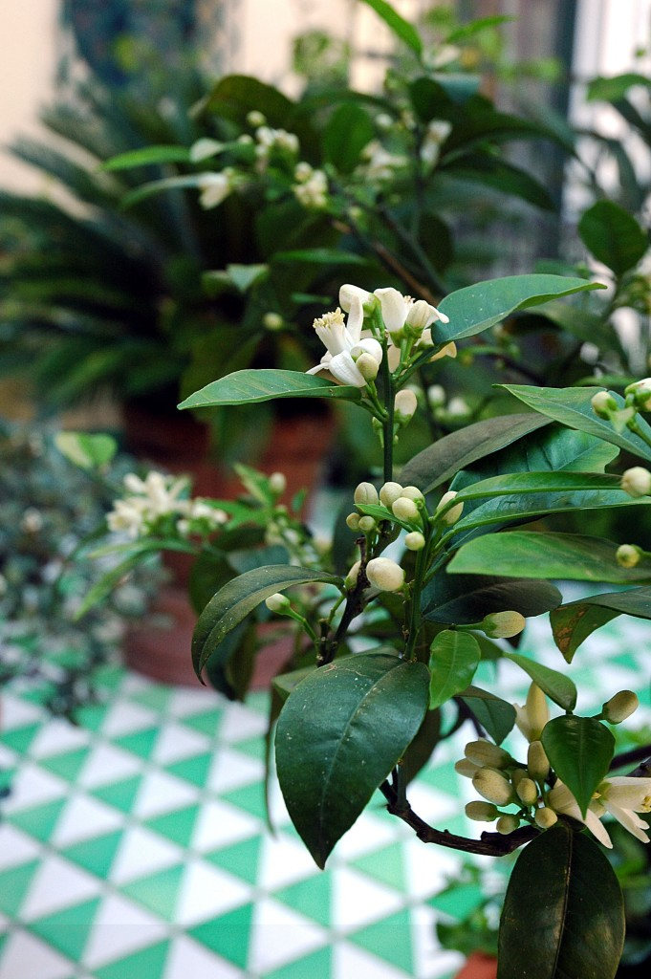

Slide 21
Palermo insegna
experience

Slide 23
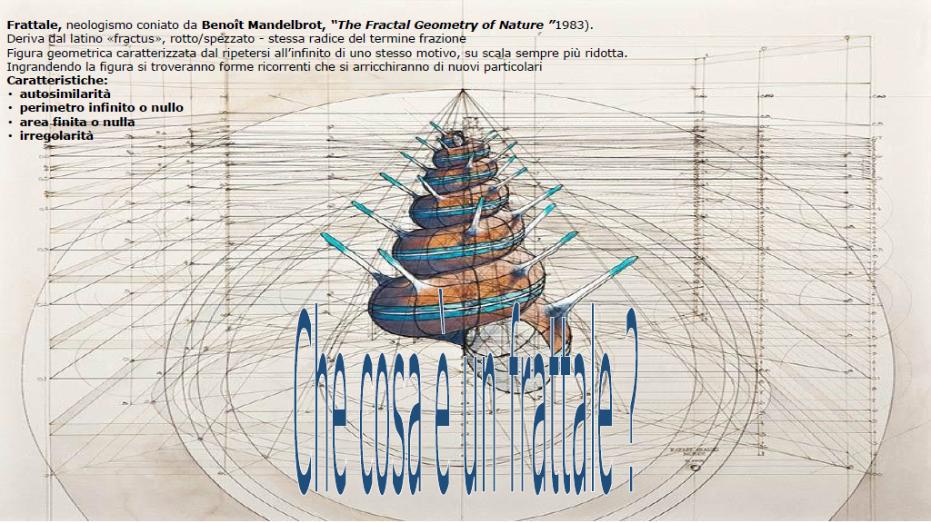

Slide 25
Fibonacci

Slide 26
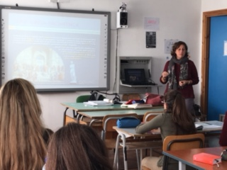
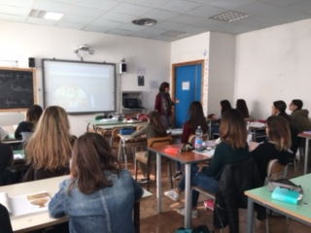
Art lesson

Slide 27
Art lesson

