Slide 1
CONIC Sections
In the 17th century, Galileo stated that our universe is a “grand book” written in the language of mathematics and its characters
are triangles, circles and other geometric figures.
From “The Assayer “ by Galileo Galilei

Slide 2
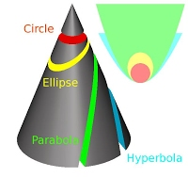
Conic sections are the intersections of a plane and a cone.

Slide 3
PARABOLA

Slide 4
It is an open curve sectioned by a cone and plane parallel to a generatrix of the cone.

Slide 5
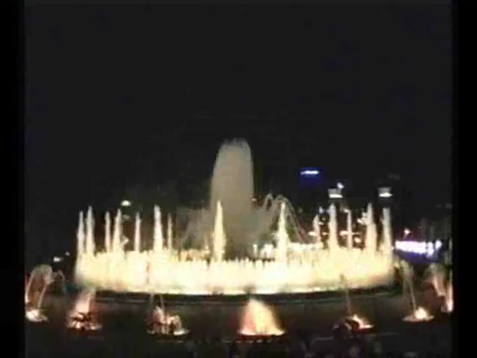
Water jets form parabolas

Slide 6
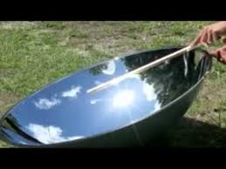
The solar rays hitting the parabolic mirror are reflected in the fire where the heat energy is very high.

Slide 7
A burning glass or burning lens is a large convex lens that can concentrate the sun rays onto a small area, heating up the area and thus resulting in ignition of the exposed surface

Slide 8
The burning mirrors were invented by the great mathematician and physicist Archimedes

Slide 9
The optical properties of parabolas are also used in common use devices

Slide 10
ELLIPSE

Slide 11
It is a type of conic section, a plane curve resulting from the intersection of a cone by a plane slightly titled compared to that perpendicular to the axis.

Slide 12
The orbits of the planets arouns the sun are ellipses.

Slide 13
In the 4th century Hypatia of Alexandria, a Greek mathematician and astronomer had already realized that the trajectory of the planets of the solar system was elliptic.

Slide 14
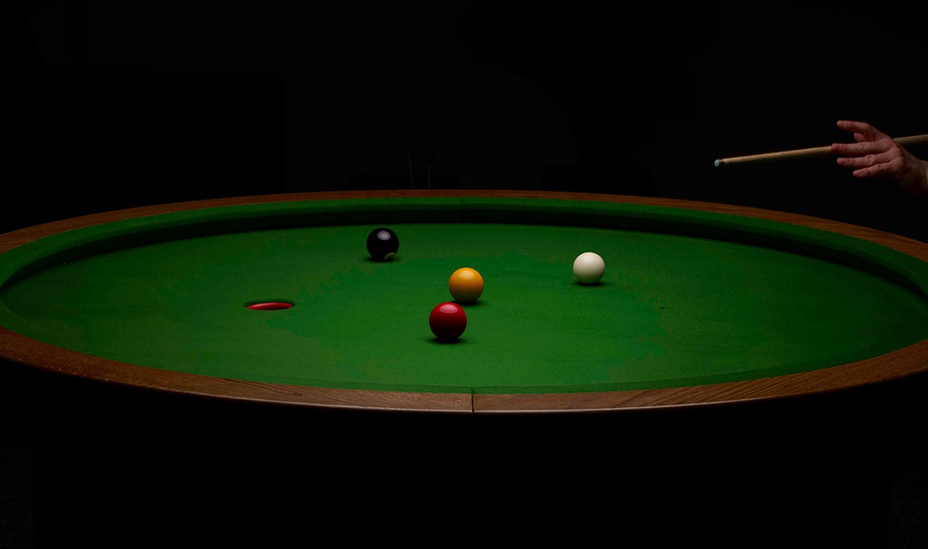
If the little ball is in one of the two fires, in any direction it is landed , it will arrive in the other fire.

Slide 15
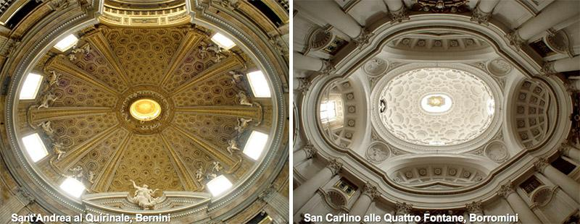
There are numerous applications in art and in architecture

Slide 16
CIRCUMFERENCE

Slide 17
The circumference is a plane curve resulting by sectioning a cone with a perpendicular plane to its axle.

Slide 18
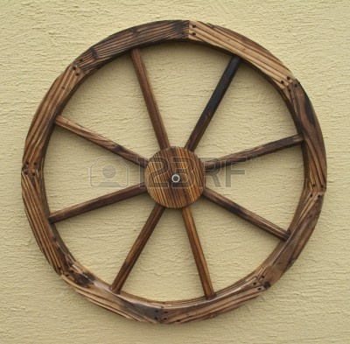
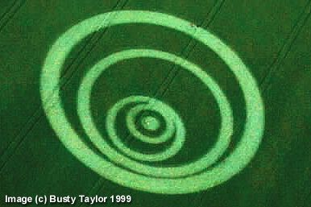
The constant curvature is a geometric property used for building a wheel .It is considered one of the most revolutionary inventions of the history and the progress of the humanity.

Slide 19
HYPERBOLA

Slide 20
It is a two-branched open curve, produced by the intersection of a circular cone and a plane that cuts both nappes of the cone.

Slide 21
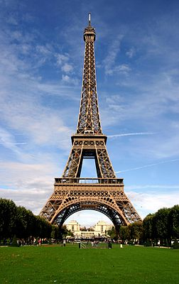
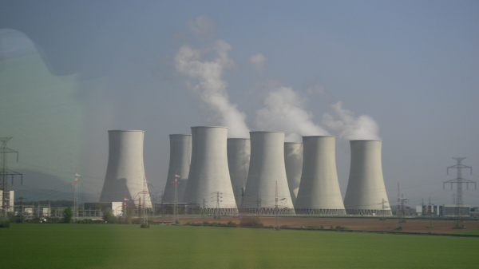
The profile of the big water cooling towers of in the industrial establishments or that of the Eiffel Tower is a hyperbole.

